Slide 1

Exhaustive Analysis Of Indian Agriculture Sector Using Power Bi
About the project
In this project we will analyzing Indian agriculture data to find various parameters of crop production, prediction based on past data and minimum support price for the given crop for the given year.

Slide 2
Tools required: power BI (business intelligence)
process used: ETA
Extract: pull the data from data source
Transform : cleaning the data , processing the data
Load : for analysis
Steps required:
Step1: Install power BI desktop
Step2: Extract the data by using csv file
Step3: load the data when data is cleaned
Step4:Transform the data when we want to process the data

Slide 3
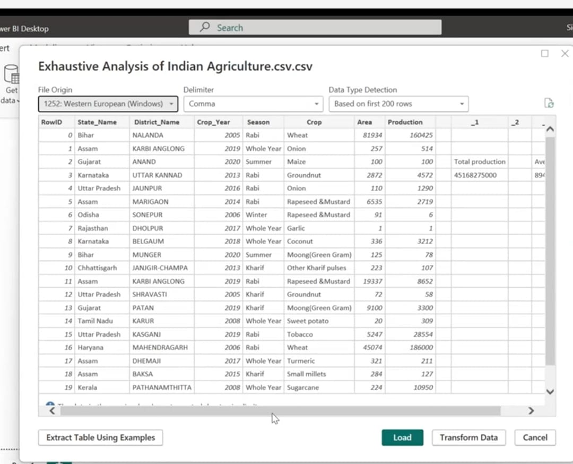

Slide 4
Report view : we perform all the visualizations
Table view : overview the data which we are dealing with
Model view : Creating the relationship among data
Transforming the data : Click on transform data button then new window opens where we can perform all the cleaning data using power query editor .By using power query editor we can transform data like removing column ,keep rows , keep column etc .
Applied steps :
1. To remove column select the column and remove .
2. Right click on it and remove unnecessary columns .
3. To check whether data contains null values or not ,click on the view then click column quality then we observe the whether column contains null values or not .

Slide 5
